Slide 1


Carbon Crusaders
EcoRewards
Presented by Prashant Anand, Timea Kadas, Liz Kent, Prateek Madnani, and Alankrita Singh
Notes:
timea

Slide 2
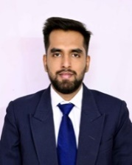




Meet the Team
Team Carbon Crusaders is focused on providing a product that can empower individuals to reduce their carbon footprint.
We are dedicated to creating solutions that will make sustainable living accessible.
Notes:
timea

Slide 3
ABOUT US​
PRASHANT ANAND – Prashant holds a Bachelor of Technology in Electrical and Electronics Engineering. He enjoys swimming, running, and traveling.
TIMEA KADAS – Timea is passionate about using data to drive innovation and efficiency, especially in projects aimed at reducing carbon emissions and promoting sustainability. Her educational background includes a Bachelor of Science in Business Administration.
LIZ KENT - Liz is a Buffalo native with a professional background in process improvement and implementation, system administration, and defect management. She is currently working as a Commercial Banking Business Data Consultant for a large regional bank.
PRATEEK MADNANI - Prateek completed his undergraduate degree in Information Science and Engineering in 2020 and has been working in the software domain since then. Prateek is passionate about technology, is an avid learner and explorer.
ALANKRITA SINGH - Before coming to the United States, Alankrita worked as an Application Engineer in India for the past 2 years. She intends to change her career path to data analytics and security as these topics interest her.
Notes:
Timea- Prashant has obtained his BTECH and has worked as an analyst at various companies. I have obtained my bachelors in business administration and I'm working on completing my masters in MIS. Liz works in commercial banking and in her free time, is an amateur photographer and plant rescuer. Prateek has been working in the software domain. He seeks to grow his technical skills and obtain a leadership role in his future. Alankrita has worked as an application engineer and is passionate about learning new things.

Slide 4


Problem Statement
Many people are unaware of how their daily activities contribute to greenhouse gas emissions, which affect climate change, global economies, agriculture, and human health.
Our goal is to raise awareness and empower individuals to reduce their carbon footprint.
We're committed to encouraging new habits that collectively improve our world.
Notes:
Timea- We believe individual actions can impact the planet's future, so we're committed to encouraging new habits that collectively improve our world.
Preserving our natural resources, building a community of individuals who are dedicated and thoughtful about the environment, and mitigating climate change to create healthier environments for current and future generations are at the heart of what we do.

Slide 5


Introducing
our solution to the carbon emissions crisis!
The overall goal of our project is to improve the environment and create a greener planet by leveraging gamification to incentive individuals to live a sustainable life.
ECOREWARDS
Notes:
Liz

Slide 6


User Experience
Log Activities
Save the Planet
View Average Carbon Emissions
Accept Recommendations
Earn Points
Notes:
Liz

Slide 7
DEVELOPMENT CYCLE
DELIVERABLES AND MILESTONES
07/16/2024 : Project description and Scope
07/23/2024: Detailed business rules and completed ER diagram
07/30/2024: Database Schema and Physical Design
08/06/2024: Populated Data and Query Output
08/15/2024: Report and Analysis Output and Presentation
REQUIREMENTS
DESIGN
DEVELOPMENT
TESTING
DEPLOYMENT
REVIEW
Notes:
Liz

Slide 8
Assumptions
All team members will participate
Project Plan will be approved
Technical resource availability
Applicable Data is sourceable
Constrains
Completion date of August 15, 2024
There will be no user interface created
Data availability
Notes:
Liz

Slide 9

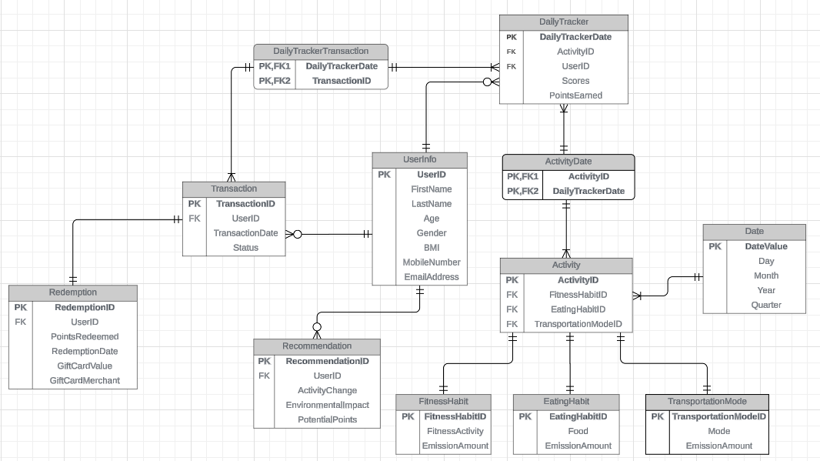
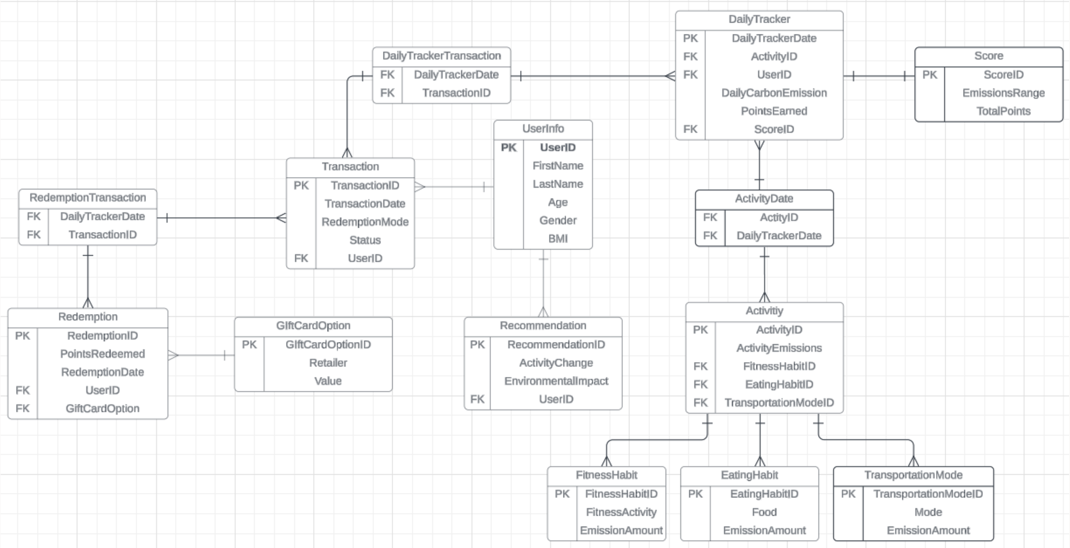
ENTITY RELATIONSHIP DIAGRAM
Notes:
Alankrita

Slide 10
Business Rules
Notes:
Alankrita

Slide 11
Each Activity must be linked to one and only one FitnessHabit, EatingHabit, or TransportationMode Table.
Each FitnessHabit Table must have one and only one fitness activity and its carbon emission amount.
Each EatingHabit Table must have one and only one fitness activity and its carbon emission amount.
Each TransportationMode Table must have one and only one fitness activity and its carbon emission amount.
Each DailyTracker entry must be linked to exactly one user (UserInfo) and must include a specific date (DailyTrackerDate).
Each Activity must have an ActivityDate linked to a DailyTrackerDate.
Each Redemption must be associated with one RedemptionTransaction.
Notes:
Alankrita

Slide 12
8. Each RedemptionTransaction which must be associated with one Transaction.​
9. Each Recommendation is associated with exactly one user (UserInfo).​
10. Each user can receive multiple recommendations.​
11. Many Transactions can be associated with one User.​
12. Each User can have multiple DailyTracker records.​
13. Multiple Activities can have the same DailyTrackerDate.​
14. Multiple Activities by different Users can be performed on the same date.​
15. Multiple transactions can be performed on the same day, having the same DailyTrackerDate.​
16. Multiple Redemption can be performed on the same date, having the same DailyTrackerDate.
Notes:
Alankrita

Slide 13
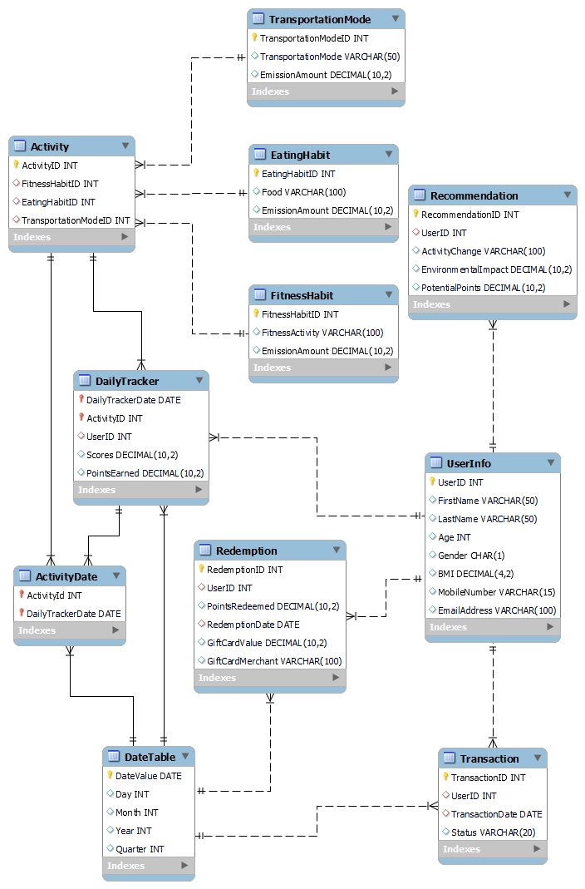
PHYSICAL DIAGRAM
Notes:
Alankrita

Slide 14
Sql
Notes:
Prateek

Slide 15
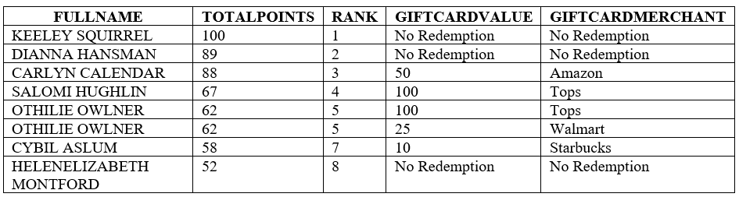
SELECT
UPPER(u.FirstName) || ' ' || UPPER(u.LastName) AS FullName,
SUM(d.PointsEarned) AS TotalPoints,
RANK() OVER (ORDER BY SUM(d.PointsEarned) DESC) AS Rank,
NVL(TO_CHAR(r.GiftCardValue), 'No Redemption') AS GiftCardValue,
NVL(r.GiftCardMerchant, 'No Redemption') AS GiftCardMerchant
FROM
DailyTracker d
JOIN
UserInfo u ON d.UserID = u.UserID
LEFT JOIN
Redemption r ON u.UserID = r.UserID
GROUP BY
u.UserID, u.FirstName, u.LastName, r.GiftCardValue, r.GiftCardMerchant
HAVING
SUM(d.PointsEarned) > 50
ORDER BY
TotalPoints DESC;
Find users who have earned more than 50 points, include their rank based on total points earned, display their names in uppercase, and show their choice of gift card redemption, handling null values and ordering by total points
Notes:
Prateek

Slide 16
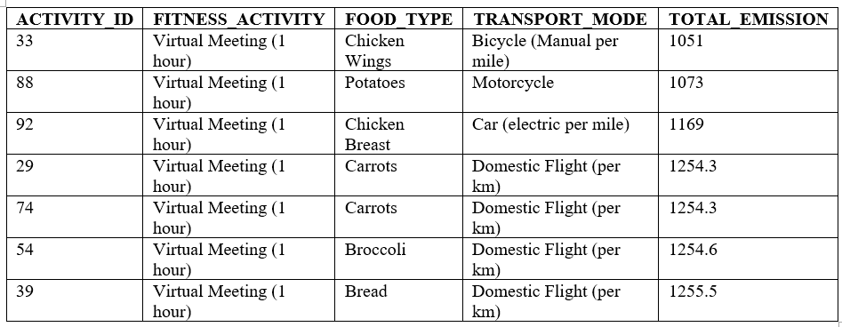
Find activities with emission amounts greater than 1000.0, alias the result, and order by total emissions ascending
SELECT
a.ActivityID AS Activity_ID,
f.FitnessActivity AS Fitness_Activity,
e.Food AS Food_Type,
t.TransportationMode AS Transport_Mode,
(f.EmissionAmount + e.EmissionAmount + t.EmissionAmount) AS Total_Emission
FROM
Activity a
JOIN
FitnessHabit f ON a.FitnessHabitID = f.FitnessHabitID
JOIN
EatingHabit e ON a.EatingHabitID = e.EatingHabitID
JOIN
TransportationMode t ON a.TransportationModeID = t.TransportationModeID
JOIN
DailyTracker d ON a.ActivityID = d.ActivityID
WHERE
(f.EmissionAmount + e.EmissionAmount + t.EmissionAmount) > 1000.0
ORDER BY
Total_Emission ASC;
Notes:
Prateek

Slide 17
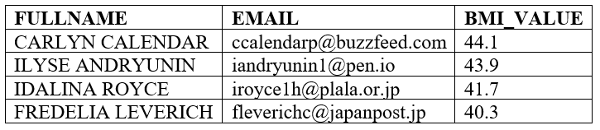
SELECT DISTINCT
UPPER(u.FirstName) || ' ' || UPPER(u.LastName) AS FullName,
LOWER(u.EmailAddress) AS Email,
NVL(TO_CHAR(u.BMI, '90.9'), '0.0') AS BMI_Value
FROM
UserInfo u
JOIN
DailyTracker d ON u.UserID = d.UserID
JOIN
Activity a ON d.ActivityID = a.ActivityID
WHERE
u.BMI > 40
ORDER BY
TO_NUMBER(NVL(TO_CHAR(u.BMI, '90.9'), '0.0')) DESC;
Retrieve distinct user details for those with BMI over 40, format names in uppercase, email in lowercase, replace null BMI with 0.0, and order by descending BMI
Notes:
Prateek

Slide 18
Find activities recorded in August 2024, calculate the total emission, and format the date
SELECT
TO_CHAR(d.DailyTrackerDate, 'DD-Mon-YYYY') AS FormattedDate,
a.ActivityID,
a.FitnessHabitID,
a.EatingHabitID,
a.TransportationModeID,
(f.EmissionAmount + e.EmissionAmount + t.EmissionAmount) AS Total_Emission,
u.UserID,
u.FirstName || ' ' || u.LastName AS FullName
FROM
Activity a
JOIN
FitnessHabit f ON a.FitnessHabitID = f.FitnessHabitID
JOIN
EatingHabit e ON a.EatingHabitID = e.EatingHabitID
JOIN
TransportationMode t ON a.TransportationModeID = t.TransportationModeID
JOIN
DailyTracker d ON a.ActivityID = d.ActivityID
JOIN
UserInfo u ON d.UserID = u.UserID
WHERE
TO_CHAR(d.DailyTrackerDate, 'MM-YYYY') = '08-2024';
Notes:
Prateek

Slide 19
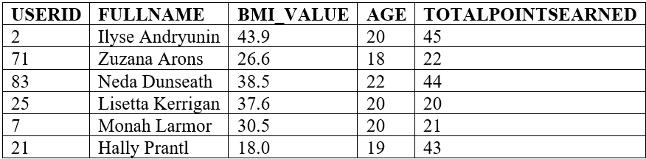
SELECT
u.UserID,
u.FirstName || ' ' || u.LastName AS FullName,
NVL(TO_CHAR(u.BMI, '90.9'), '0.0') AS BMI_Value,
u.Age,
SUM(d.PointsEarned) AS TotalPointsEarned
FROM
UserInfo u
JOIN
DailyTracker d ON u.UserID = d.UserID
WHERE
u.Age < 24
GROUP BY
u.UserID, u.FirstName, u.LastName, u.BMI, u.Age
ORDER BY
u.LastName;
Display user full name, age, replace null BMI with 0.0, include points, and filter by users younger than 24
Notes:
Prateek

Slide 20
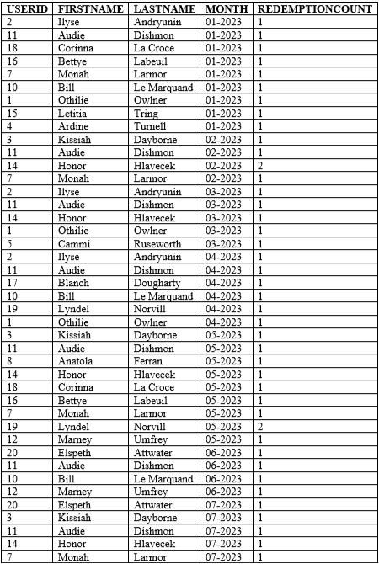
Count and display distinct redemptions per user for 2023, grouped by user and month, and ordered by month and last name
SELECT DISTINCT
u.UserID,
u.FirstName,
u.LastName,
TO_CHAR(r.RedemptionDate, 'MM-YYYY') AS Month,
COUNT(r.RedemptionID) OVER (PARTITION BY u.UserID, TO_CHAR(r.RedemptionDate, 'MM-YYYY')) AS RedemptionCount
FROM
UserInfo u
JOIN
Redemption r ON u.UserID = r.UserID
WHERE
TO_CHAR(r.RedemptionDate, 'YYYY') = '2023'
ORDER BY
TO_CHAR(r.RedemptionDate, 'MM-YYYY'), u.LastName;
Notes:
Prateek

Slide 21


Slide 22
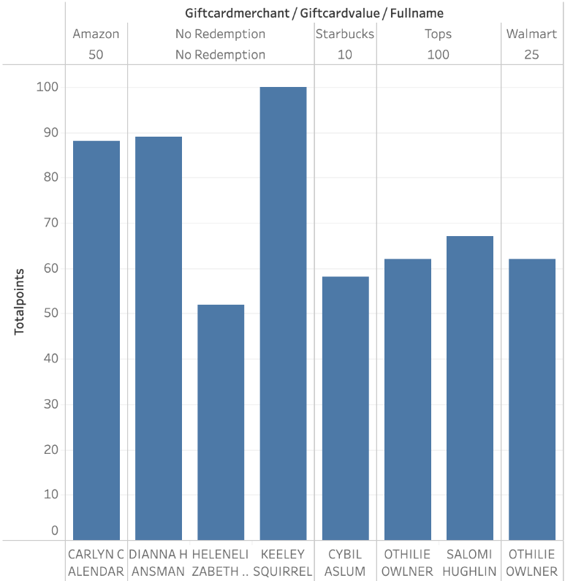
Gift Card Redemption Choice for Users
Notes:
Prashant

Slide 23
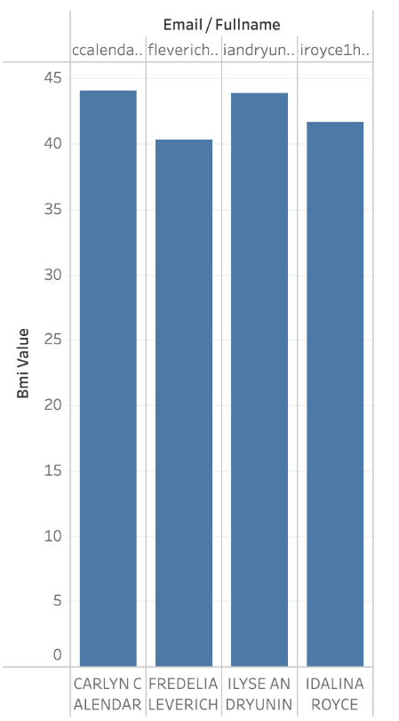
Users with BMI Values > 40
Notes:
Prashant

Slide 24
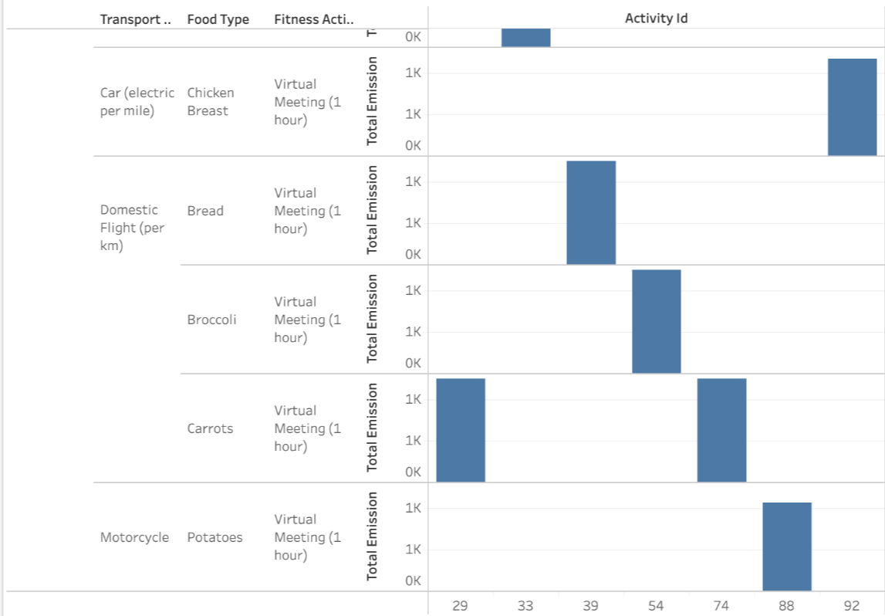
Activities with Total Emissions
Notes:
Prashant

Slide 25
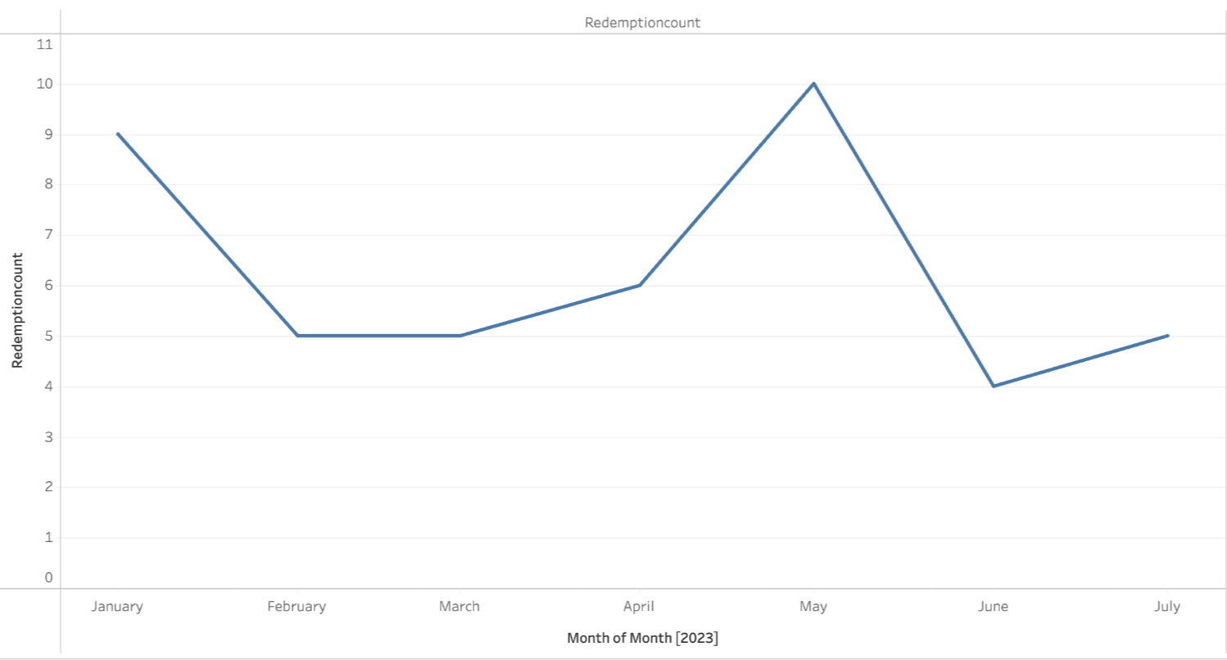
Redemptions per Month in 2023
Notes:
Prashant

Slide 26
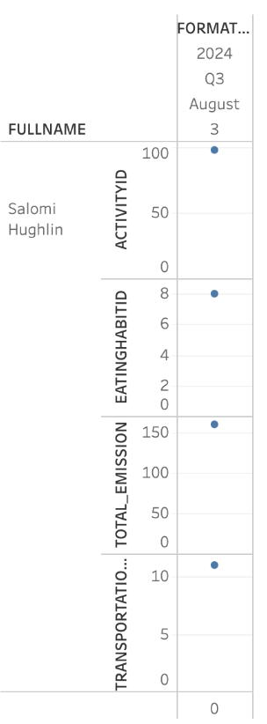
Activities and Total Emissions Recorded in August in 2024
Notes:
Prashant

Slide 27
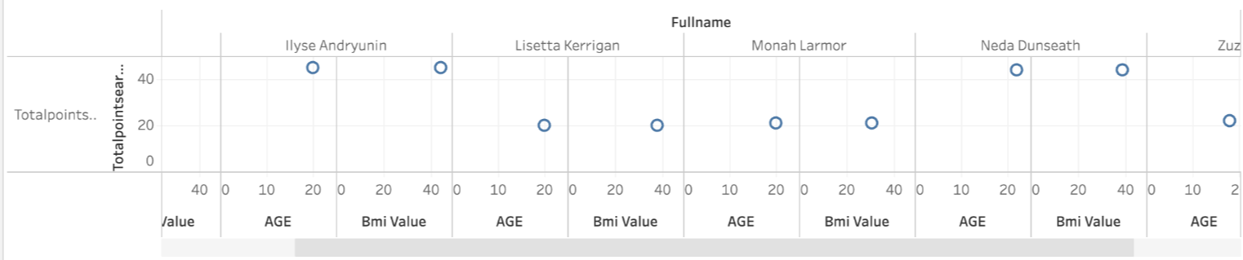
Users' Total Points and BMI for Ages < 24
Notes:
Prashant

Slide 28
Q&A

